Slide 1


Day 5 of Machine Learning Workshop
-Dikshita Padte

Slide 2


Machine Learning Algorithms

Slide 3

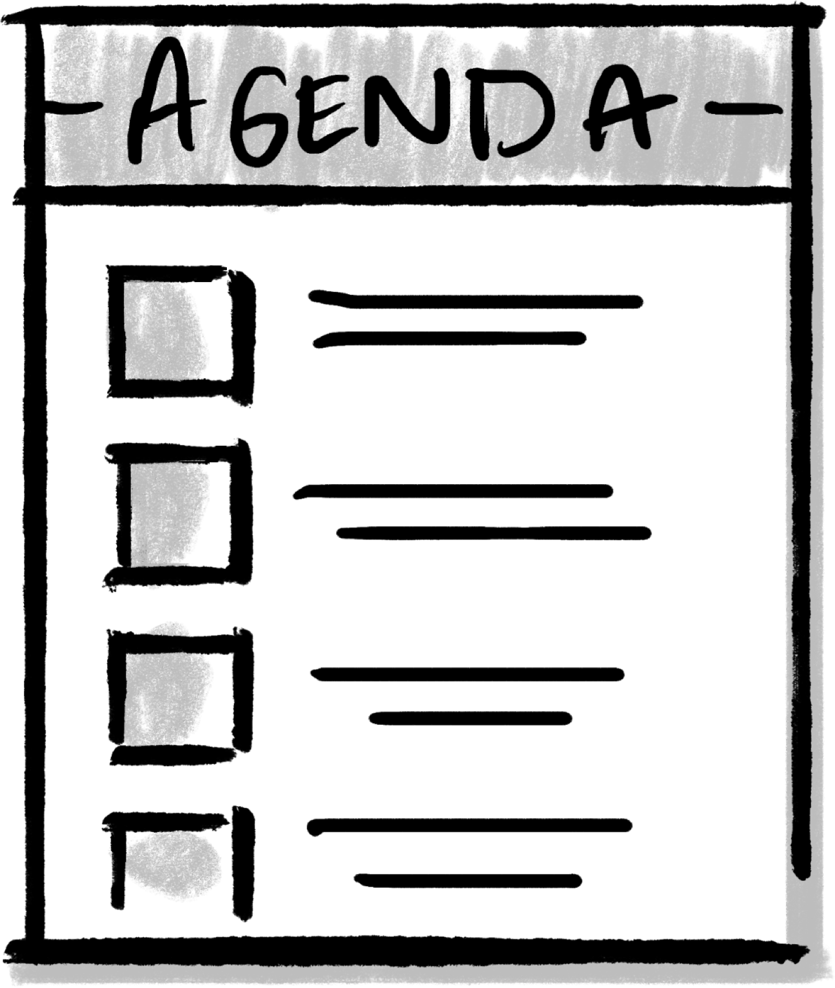
1. Introduction to Machine Learning Algorithms
2. Understanding the prerequisites for applying the algorithmns to your model
3. Naïve Bayes Classifier
4. Linear Regression
5. Practical Implementation of these Algorithms using a Dataset

Slide 4
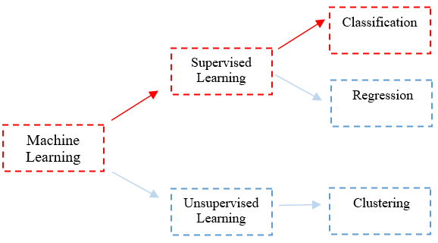

Slide 5
What is Classification??
Classification is the process of dividing the datasets into different categories or groups by adding labels. In other words,it is a technique of categorizing different observations into different categories.
Note: It adds the data points to a particular labelled group on the basis of some condition.

Slide 6
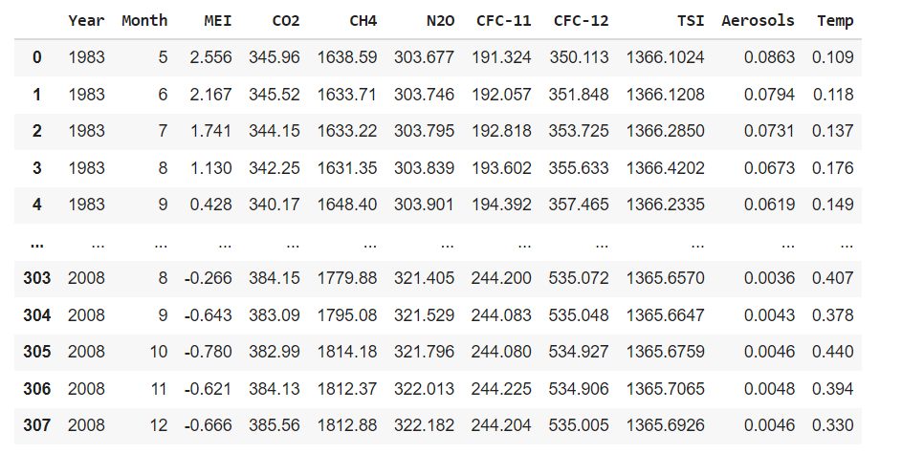

Slide 7
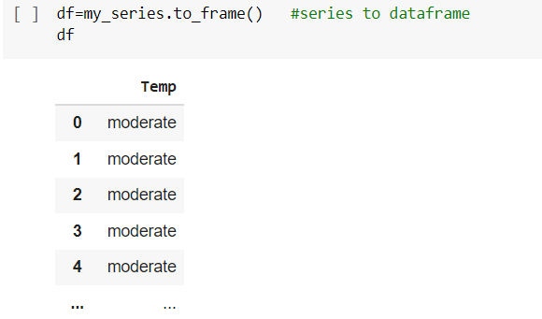

Slide 8
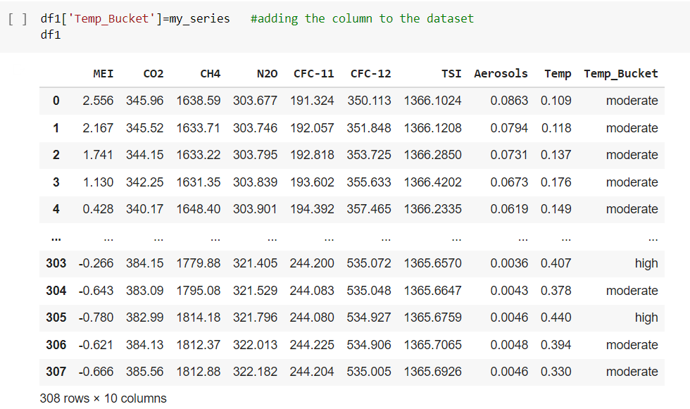

Slide 9
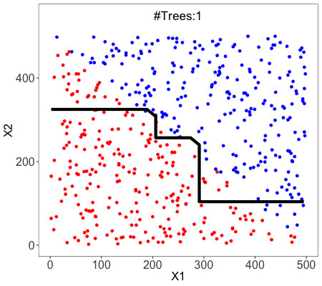
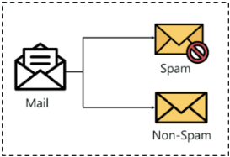
Classification is a process of categorizing a given set of data into classes. The classes are often referred to as target, label or categories.

Slide 10
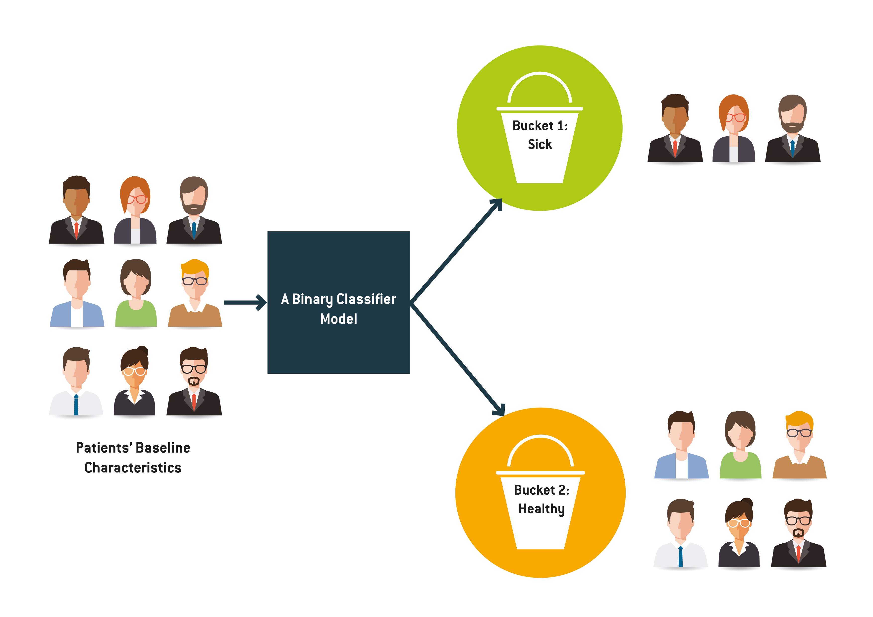
There are two types of Classifications:
Binary Classifier: If the classification problem has only two possible outcomes, then it is called as Binary Classifier. Examples: YES or NO, MALE or FEMALE, SPAM or NOT SPAM, CAT or DOG, etc.

Slide 11
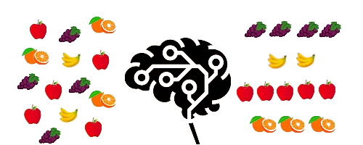
Multi-class Classifier: If a classification problem has more than two outcomes, then it is called as Multi-class Classifier. Example: Classifications of types of crops, Classification of types of music.

Slide 12

Types of Classification Algorithms
K Nearest Neighbors
Decision Tree Classifier
Logistic Regression
Naïve Bayes Classifier
Support Vector Machines

Slide 13

Where is classification used??
Classifying spam folders
Fraud Detection
To check whether the transaction is genuine or not.

Slide 14
What is Regression?
Regression analysis is a statistical method to model the relationship between a dependent (target) and independent (predictor) variables with one or more independent variables. More specifically, Regression analysis helps us to understand how the value of the dependent variable is changing corresponding to an independent variable when other independent variables are held fixed.
It predicts continuous/real values such as temperature, age, salary, price, etc.

Slide 15
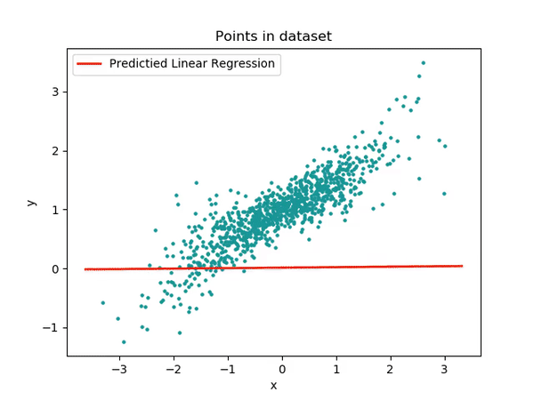
In Regression, we plot a graph between the variables which best fits the given datapoints, using this plot, the machine learning model can make predictions about the data. In simple words,
"Regression shows a line or curve that passes through all the datapoints on target-predictor graph in such a way that the vertical distance between the datapoints and the regression line is minimum."
The distance between datapoints and line tells whether a model has captured a strong relationship or not.

Slide 16
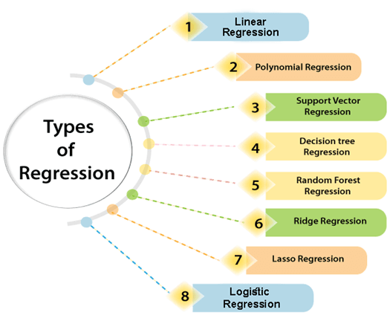
Linear Regression
Ridge Regression
Neural Network Regression
Lasso Regression
Gausian Regression
Polynomial Regression
Quantile Regression Bayesian Linear Regression Principal Components Regression Partial Least Squares Regression Elastic Net Regression

Slide 17
Some examples of regression can be as:
1. Prediction of rain using temperature and other factors
2. Determining Market trends
3. Prediction of road accidents due to rash driving.

Slide 18
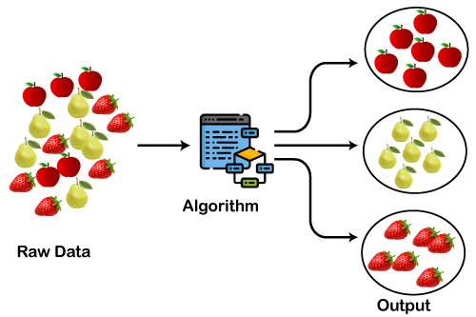
What is Clustering?

Slide 19
"A way of grouping the data points into different clusters, consisting of similar data points. The objects with the possible similarities remain in a group that has less or no similarities with another group."
Cluster is the collection of data objects which are similar to one another within the same group (class or category) and are different from the objects in the other clusters.

Slide 20
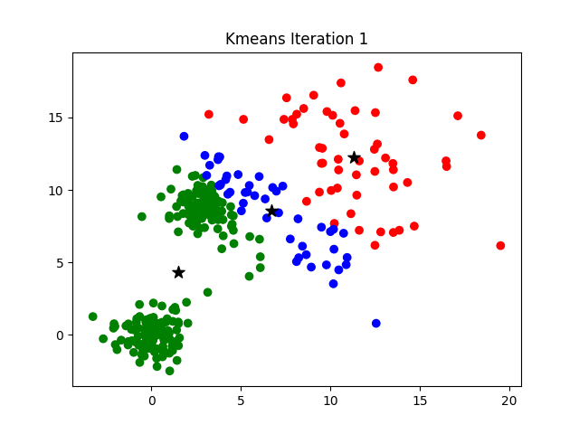
Apart from these general usages, it is used by the Amazon in its recommendation system to provide the recommendations as per the past search of products. Netflix also uses this technique to recommend the movies and web-series to its users as per the watch history.

Slide 21
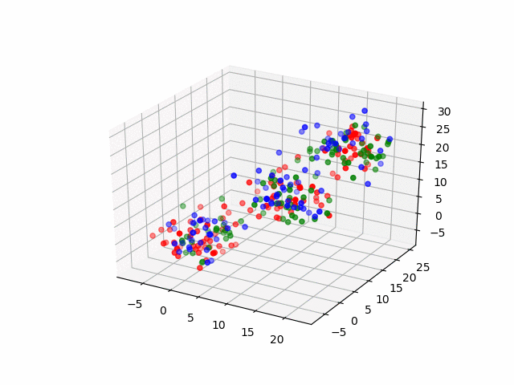

Slide 22
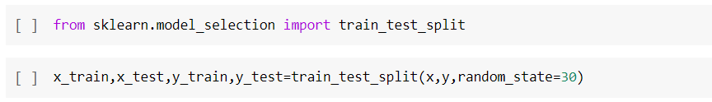
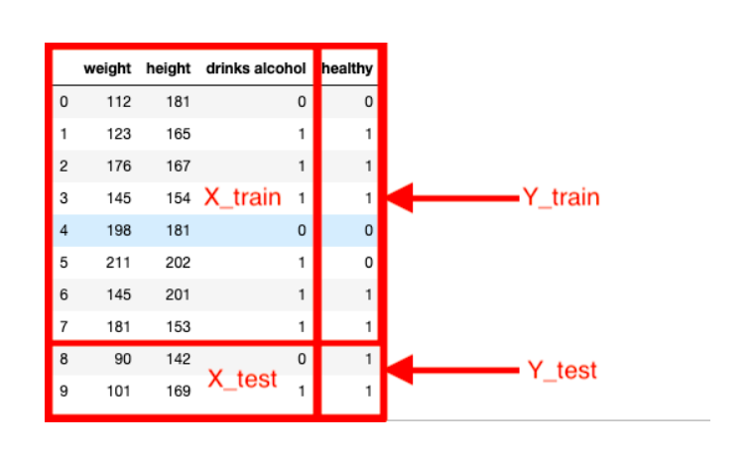

Slide 23

Lets Have some Break!!!!!!!!!!!!

